Slide 1

Embedded Cryptography and Side-Channel Analysis From past to present … and beyond …
Benoît Feix
STMicroelectronics
Cryptis Master2, October 2024.

Slide 2
Agenda
1
Hardware attacks
5
Post Quantum Cryptography
2
Side-channel is coming
6
Resources, nowadays
3
A taste of RSA
7
Attack potential and standards
4
Side-channel methodology

Slide 3
Agenda
Past: from 90’s ... Before Kocher ..
Designing a security product
Invasive Attacks and Countermeasures
96’s: (well?)coming side-channel attacks
Simple Analysis, explanations, demos
Differential Analysis, DPA, CPA, demos on DES and AES
Countermeasures, High Order on Symmetric Algorithm and CMs: demo
Back to RSA
Differential Analysis: demo
Countermeasures
Side-channel Methodology
Demos on t test and reverse analysis
Nowadays
No more ‘confidential’ science, open sources and CTF
Recent attacks
Post Quantum Cryptography
Standard and attack ratings in the industry

Slide 4
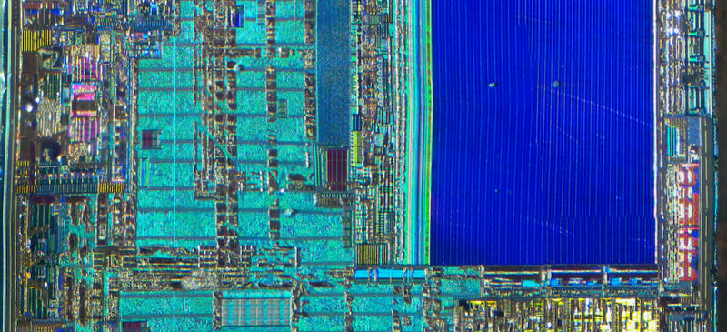
Secure Products Invasive Attacks and Countermeasures

Slide 5
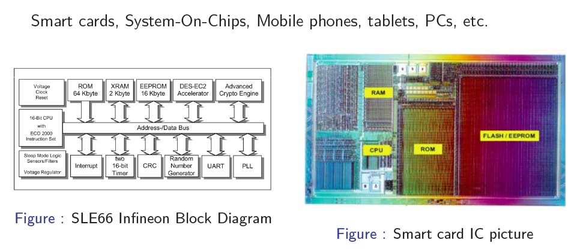
Started with smart cards …

Slide 6
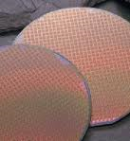
Integrated Circuit Architecture
Processor:
8, 16 or 32 bits
CISC or RISC
Harvard or Von Neumann
ROM: Read Only Memory
RAM: Random Access Memory
EEPROM: Electrically Erasable Programmable Read Only Memory
Flash: NOR or NAND – close to EEPROM
RNG: Random Number Generator
Coprocessors for:
TDES, AES
CRC, HASH
Long Integer Arithmetic (RSA, ECDH, ECDSA)
In/Out IPs
MPU/MMU: Memory Management Unit
Security sensors

Slide 7
Product Conception Phases
Circuit Intégré
Développement
OS
Développement
CRYPTO
Développement
Tests
Production
Préparation
Applications
Développement
Sécurisation
Produit
Fabrication
Photomasks
Fonderie
Personnalisation
Pré
personnalisation
Initialisation
Tests
Pré
personnalisation

Slide 8
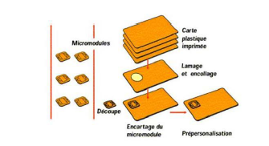
Different Phases From User to End-Of-Life cycles
Mise en circulation
- Traitement des commandes
- Mises à jour (modifications données)
Gestion du Parc
Fin de vie
- Désactivation,
- Usure fonctionnelle
- Casse
- Remplacements
- Vols, oppositions, pertes

Slide 9
Standard Crypto Algorithms in Products
Symmetric
DES/TDES: NIST recommendation now TDES EDE3 for 2⁴⁰ use of same key
AES 128-192-256
SM4, SEED, FEAL-32
Hash Functions
SHA-1, SHA-256
RIPEMD 160
SHA-3: KECCAK
HMAC Functions
SM3
Asymmetric
CRT-RSA – RSA SFM (≥ 2048 bit)
DSA / ECDSA (i.e. GF-P256)
DH / ECDH
OBKG, Kgen
SM2
And also …
DRBG, example: AES-CTR based i.e. NIST SP800-90
Stream Ciphers
Lightweight crypto
Post Quantum Cryptography

Slide 10
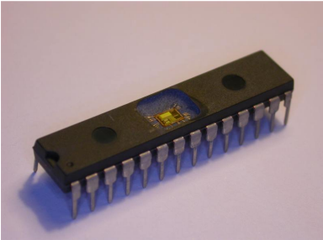
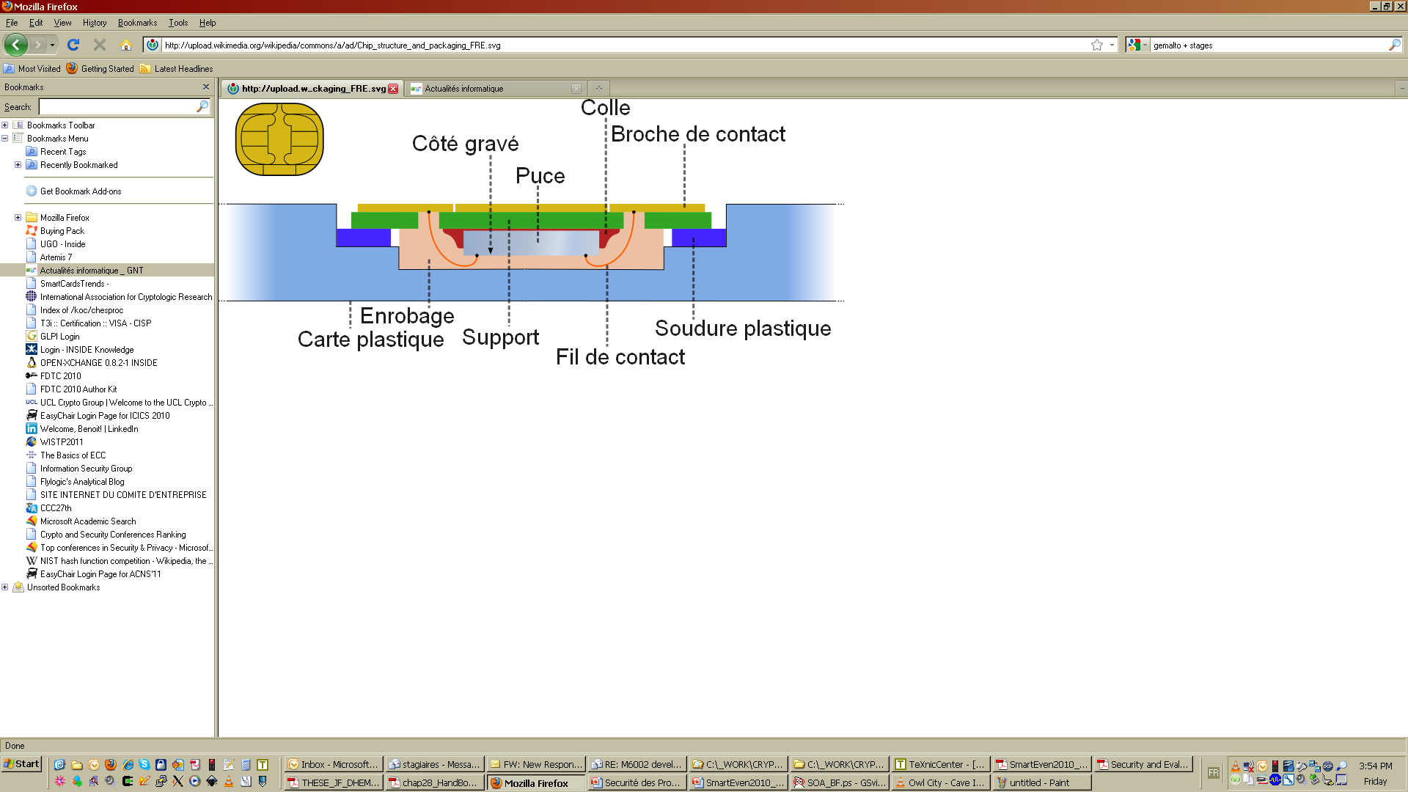
Reverse Engineering
Accessing to the circuit
Remove plastic or open with a knife or cutter
Use chemical products to remove (destroy) epoxy (resin) with nitric acid and acetone …
We observe now the chip that we can analyze using microscope(s)
Reconnect the circuit on another ‘’package’’
In order to use it again we reconnect the IO pins, clock pins, VCC pads, etc.
We can then analyze the IC when running with several tools

Slide 11
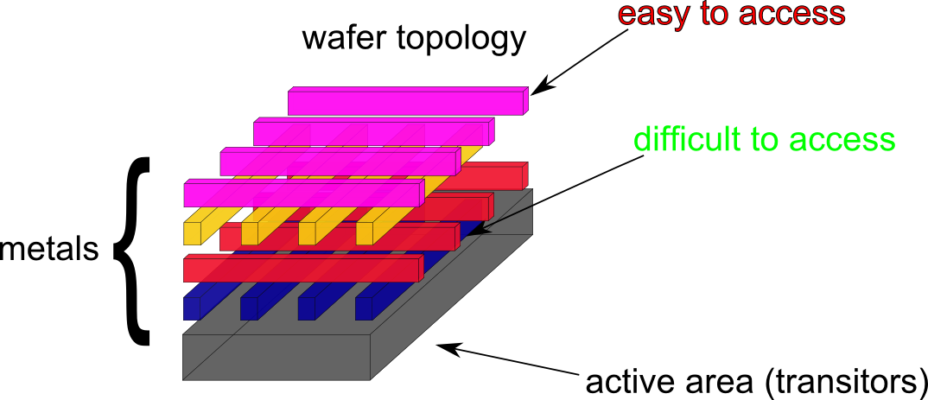
Reverse Engineering Reverse the IC Layout
Re-assemble metal layers
Integrated Circuit = SUM of metal layers interconnected each others
Using an optical microscope we can observe and take a picture of each metal layer
We start at the higher (upper) layer
We remove chemically this layer with fluoric acid or a plasma machine
We iterate until we reach the lowest layer (metal 1)

Slide 12
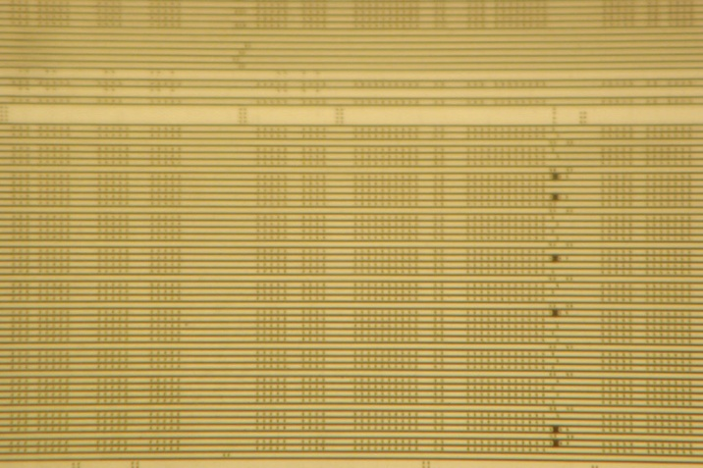
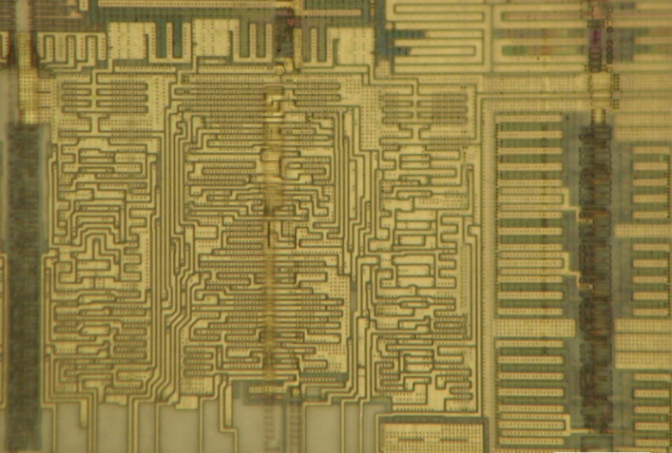
Reverse Engineering Reverse the Layout
View of top métal
View of 1 metal lower after removal of top metals
We can the reconstitute the IC whole structure
This operation is very complex and time consuming
In real life it is faster to focus on area of interest with a precise attack path

Slide 13
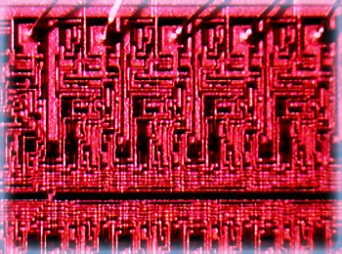
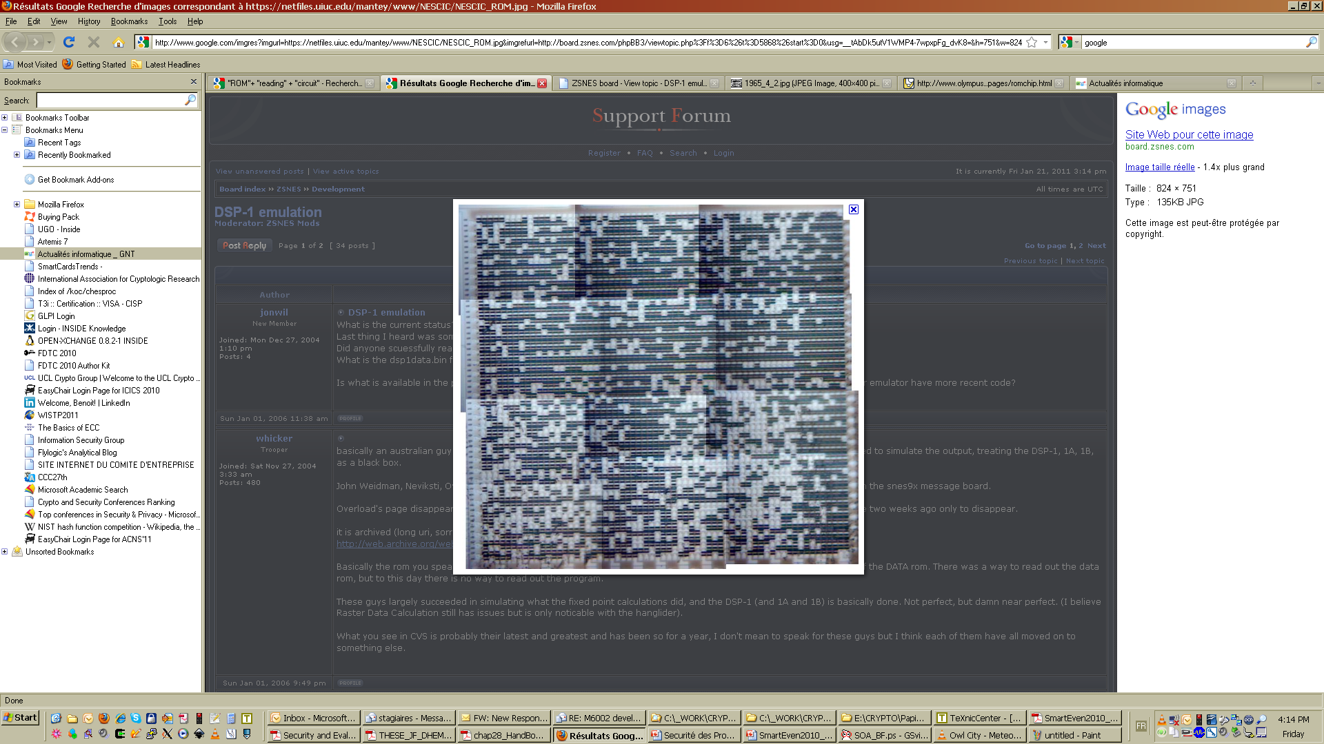
Reverse Engineering Read Memories Content
Extract (read) the not volatile memories content (data, code).
RAM, EEPROM, FLASH : difficult but possible
ROM:
Easier
Related to the kind of memory (diffused or not)
Require different techniques
Depend to the technological node:
90nm, 65nm
28nm (!)
7nm is the current best techno

Slide 14
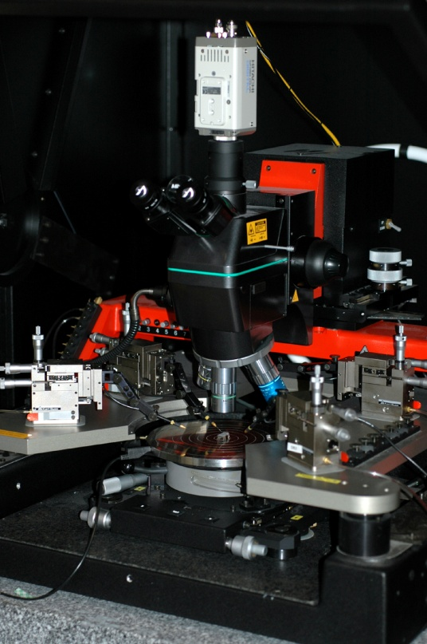
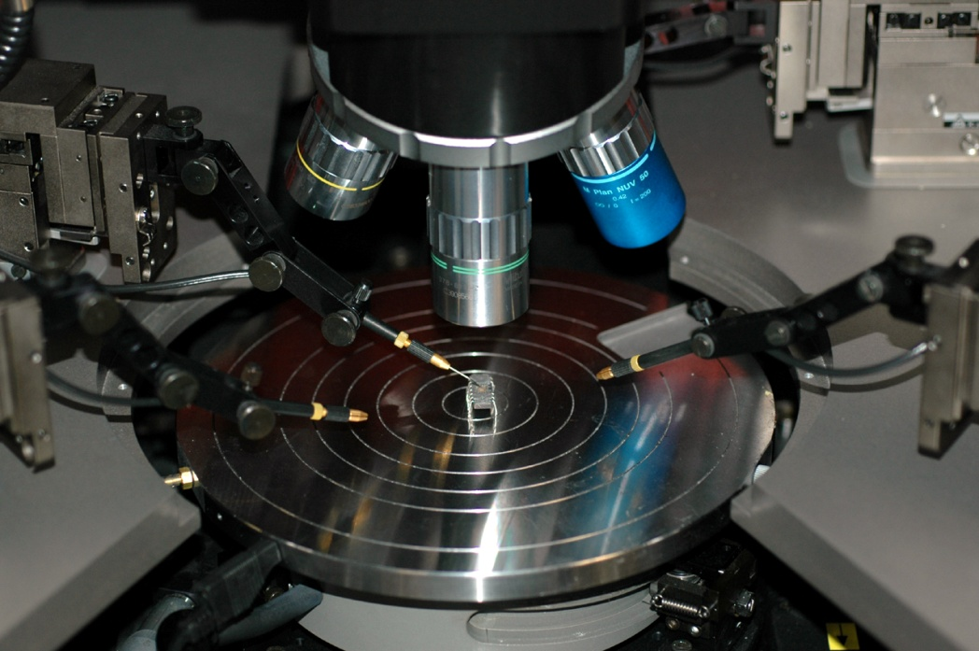
Read/Modify bits with Probing
Require a probe station

Slide 15
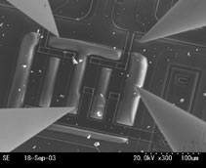
Read/Modify bits with Probing
We position one or more probes on a circuit area to ‘’read’’ or ‘’change/flip’’ a value (bits):
For instance, the bit lines in a data bus, or code bus
For instance, you can read a key value transferred on a bus to a memory or register
You change the key bits ..
Etc.

Slide 16
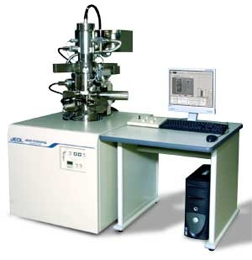
Modify the Circuit Focused Ion Beam (FIB)
FIB (Focused Ion Beam ) stations are most often used to analyze (and “debug”) failures in circuits
FIB can
‘’remove’’ metal, and modify connections
He can add metal and then create new connections
Then an ATTACKER can
Access to “hidden” signals at lower metal levels
Modify the circuit (behavior)
Very expensive .. But low cost for renting !

Slide 17
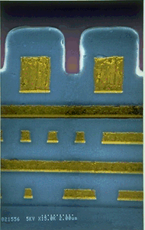
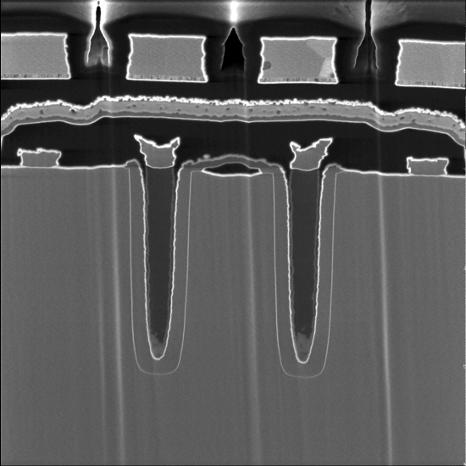
Modify the Circuit Focused Ion Beam (FIB)
Cross Sections
Very powerful tool
Can defeat product security
Expensive
Can be rent
Usage to be be monitored

Slide 18
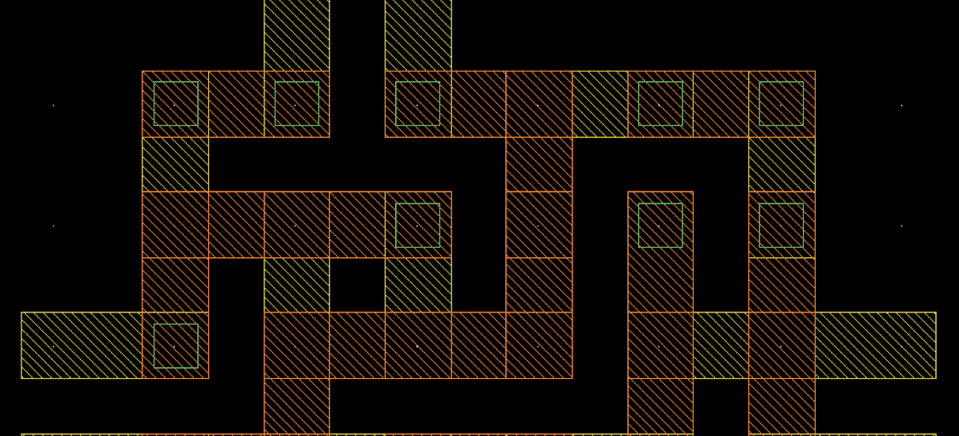
Countermeasures Vs. Invasive Attacks

Slide 19
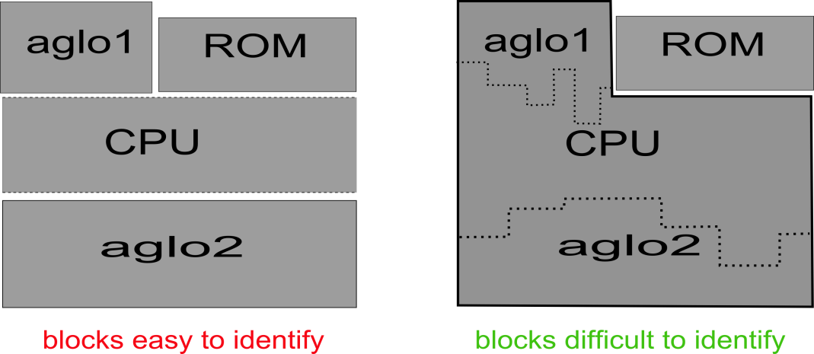
IC Reverse Engineering Countermeasures
Make design more complex
Embed sensitive lines in lower levels
Use thinner technologies (< 65 nm)
Make the structure more compact (i.e.. Glue logic)
Glue Logic
Makes the IP and block localization
difficult to the attacker
IP easy to locate IP more difficult to locate

Slide 20
Reverse Engineering on Memories Countermeasures
Use memory technology more difficult to reverse
Apply Scrambling / Permutations on data (addresses)
Apply secret permutation to the data bits to make difficult the bit assembly once the memory has been reversed
Can be software or hardware dedicated IPs
Hardware Data Encryption
Data in memory are never in plain
Encrypted with a cryptographic algorithm
Must be very efficient as applied for each READ/WRITE access in memory
Decryption for each memory read
Encryption for each memory write
Same for registers, etc.
Difficult to design such algorithms (not a XOR with a hardcoded key please)
Mandatory for serious products
Software Encryption
Is recommended to be added at software level for (very) sensitive assets

Slide 21
Probing Countermeasures
Passive Shield (insufficient)
Full metal level on the top of the IC to “forbid” the access
Active Shield/Mesh (efficient)
Full metal on top of the shield
Embed active lines interconnected
Touch or Cut a line and you will be detected by the shield sensors connected to the active lines
https://hal.science/hal-00721569v2/document
Be a Clever Designer
place sensitive buses, registers (data or configuration) in area difficult to access to a probe
Integrity Check on data flow
Will detect a probe modification on data as integrity will not be coherent
Memories/Buses/Registers Encryption

Slide 22
FIB Countermeasures
Active Shield/Mesh (efficient)
Full metal on top of the shield
Touch or Cut a line and you will be detected by the shield sensors connected to the active lines
Be a Clever Designer
place sensitive buses, registers (data or configuration) in area difficult to access to a probe
Difficult
With more and more efforts FIB can counterfeit most of the protection
Matter of time and money and techno used
Embed active lines interconnected

Slide 23
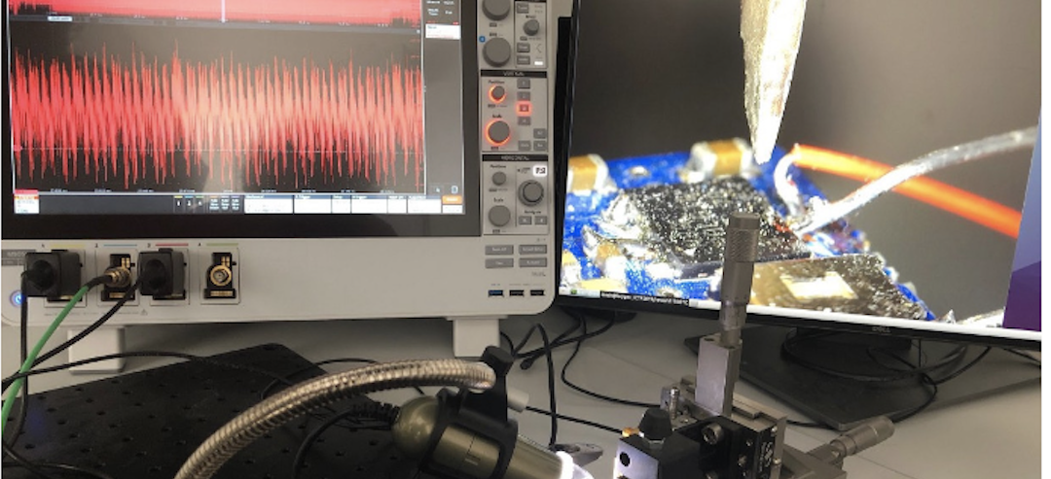
96’s: (well?)coming timing and side-channel attacks

Slide 24
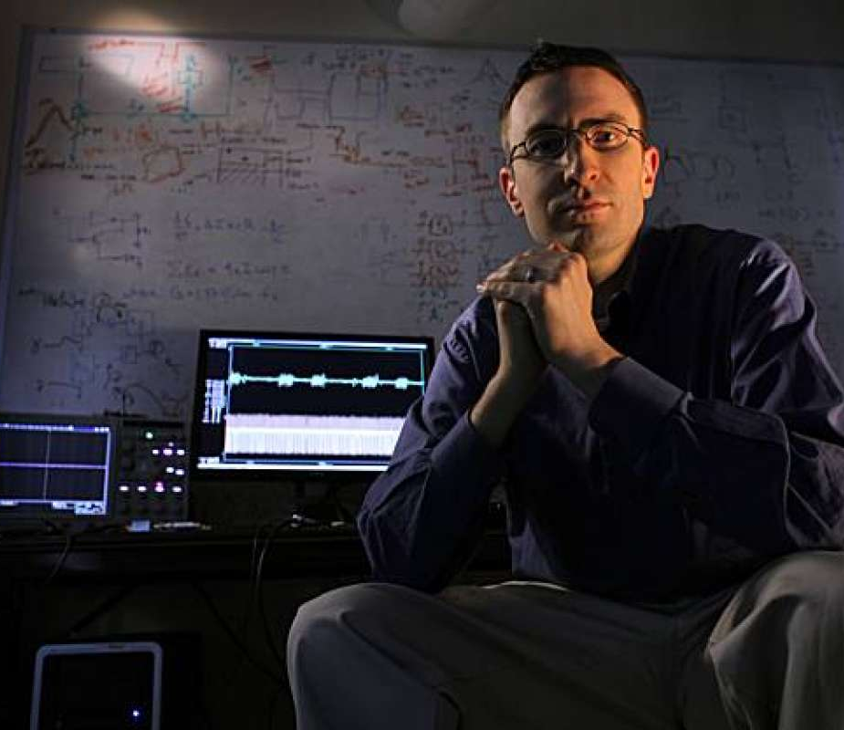
Timing Attack and Simple Power Analysis
1996 – P. Kocher first publication at Crypto conference
Exploited timing analysis to recover the secret key used in RSA exponentiation thanks to several executions timing measurements
1998 – P. Kocher, B. Jaffe and Jun – SPA on RSA.
Published on the CRI website.

Slide 25
Some side-channel history
1999 – P. Kocher, J. Jaffe and B. Jun – first DPA publication on DES
Paper: Differential Power Analysis. Crypto 1999.
1999 – T.S. Messerges, E.A. Dabbish and R.H Sloan – DPA on RSA
Power Analysis of Modular Exponentiation in Smartcards. CHES 1999.
2000 – T.S Messerges – Second Order Power Analysis
Using Second-Order Power Analysis to Attack DPA Resistant Software. CHES 2000.
2003 – E. Brier, C .Clavier and F. Olivier: CPA
Correlation Power Analysis with a Leakage Model CHES 2004 (IACR 2003).
2008 – B. Gierlichs, L. Batina, P. Tuyls and B. Preneel: MIA
Mutual Information Analysis. CHES 2008
2010 – A. Moradi, O. Mischke, and T. Eisenbarth: Collision Correlation on AES
Correlation-Enhanced Power Analysis Collision Attack. CHES 2010

Slide 26
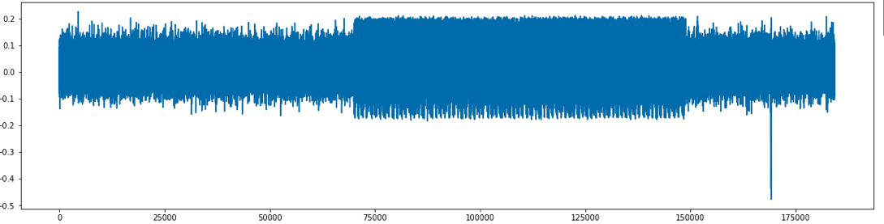
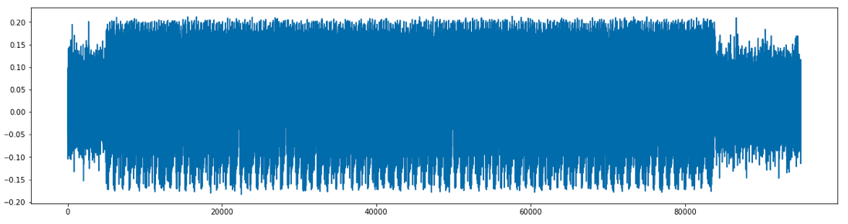
What is this?

Slide 27
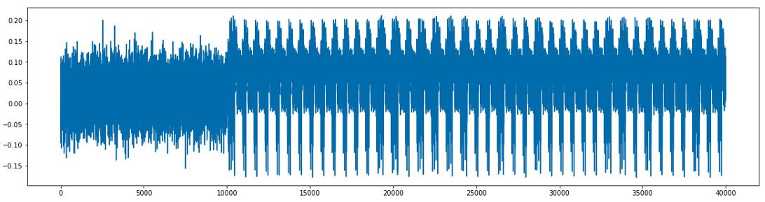
What is this?
Zooming you identify loop of multiplications
→ RSA exponentiation

Slide 28
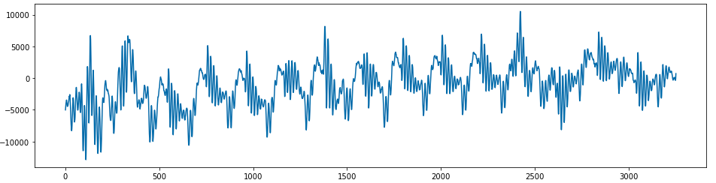
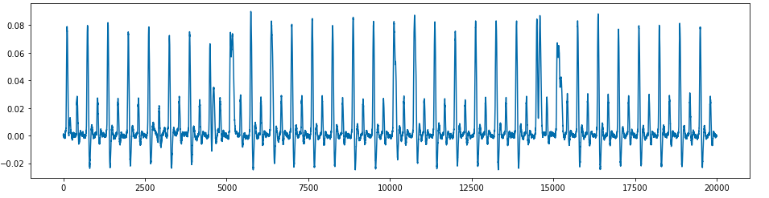
These ones?

Slide 29
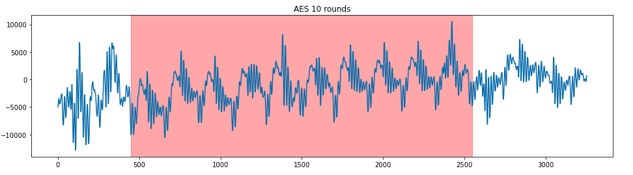
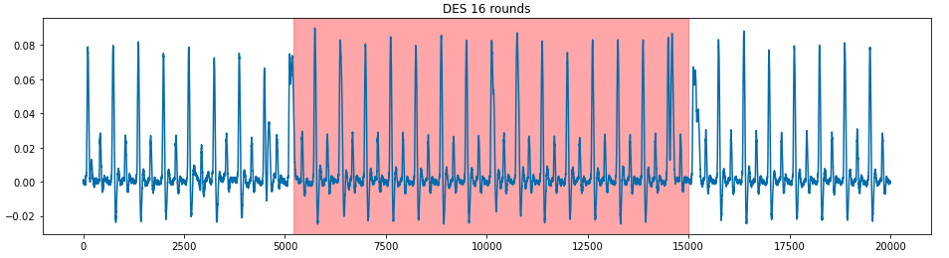
These ones?

Slide 30
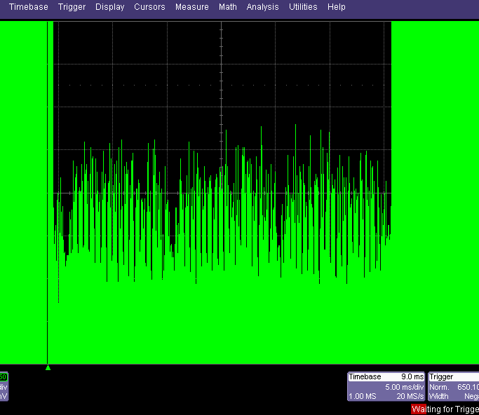
Triple DES

Slide 31
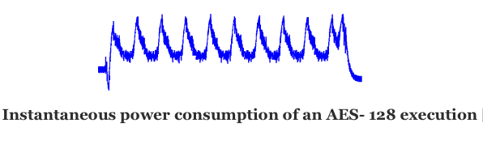
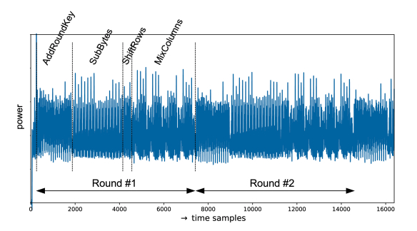
Good AES Example Reading
From Francois Durvaux
SCA-Pitaya: A Practical and Affordable Side-Channel Attack Setup for Power Leakage–Based Evaluations
https://dl.acm.org/doi/fullHtml/10.1145/3371393

Slide 32
Side-channel Leakage Origin
Devices are done using CMOS technology where the device power consumption varies depending on:
The type of operation (code) executed
The data manipulated by the hardware
Leakage models mostly considered in literature and practice
Hamming weight: power consumption = F(data)
Hamming distance: power consumption = F(reference_state XOR data)
Single bit or multi-bit
Direct value

Slide 33
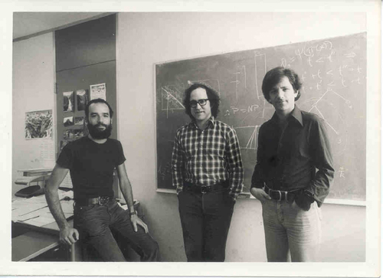
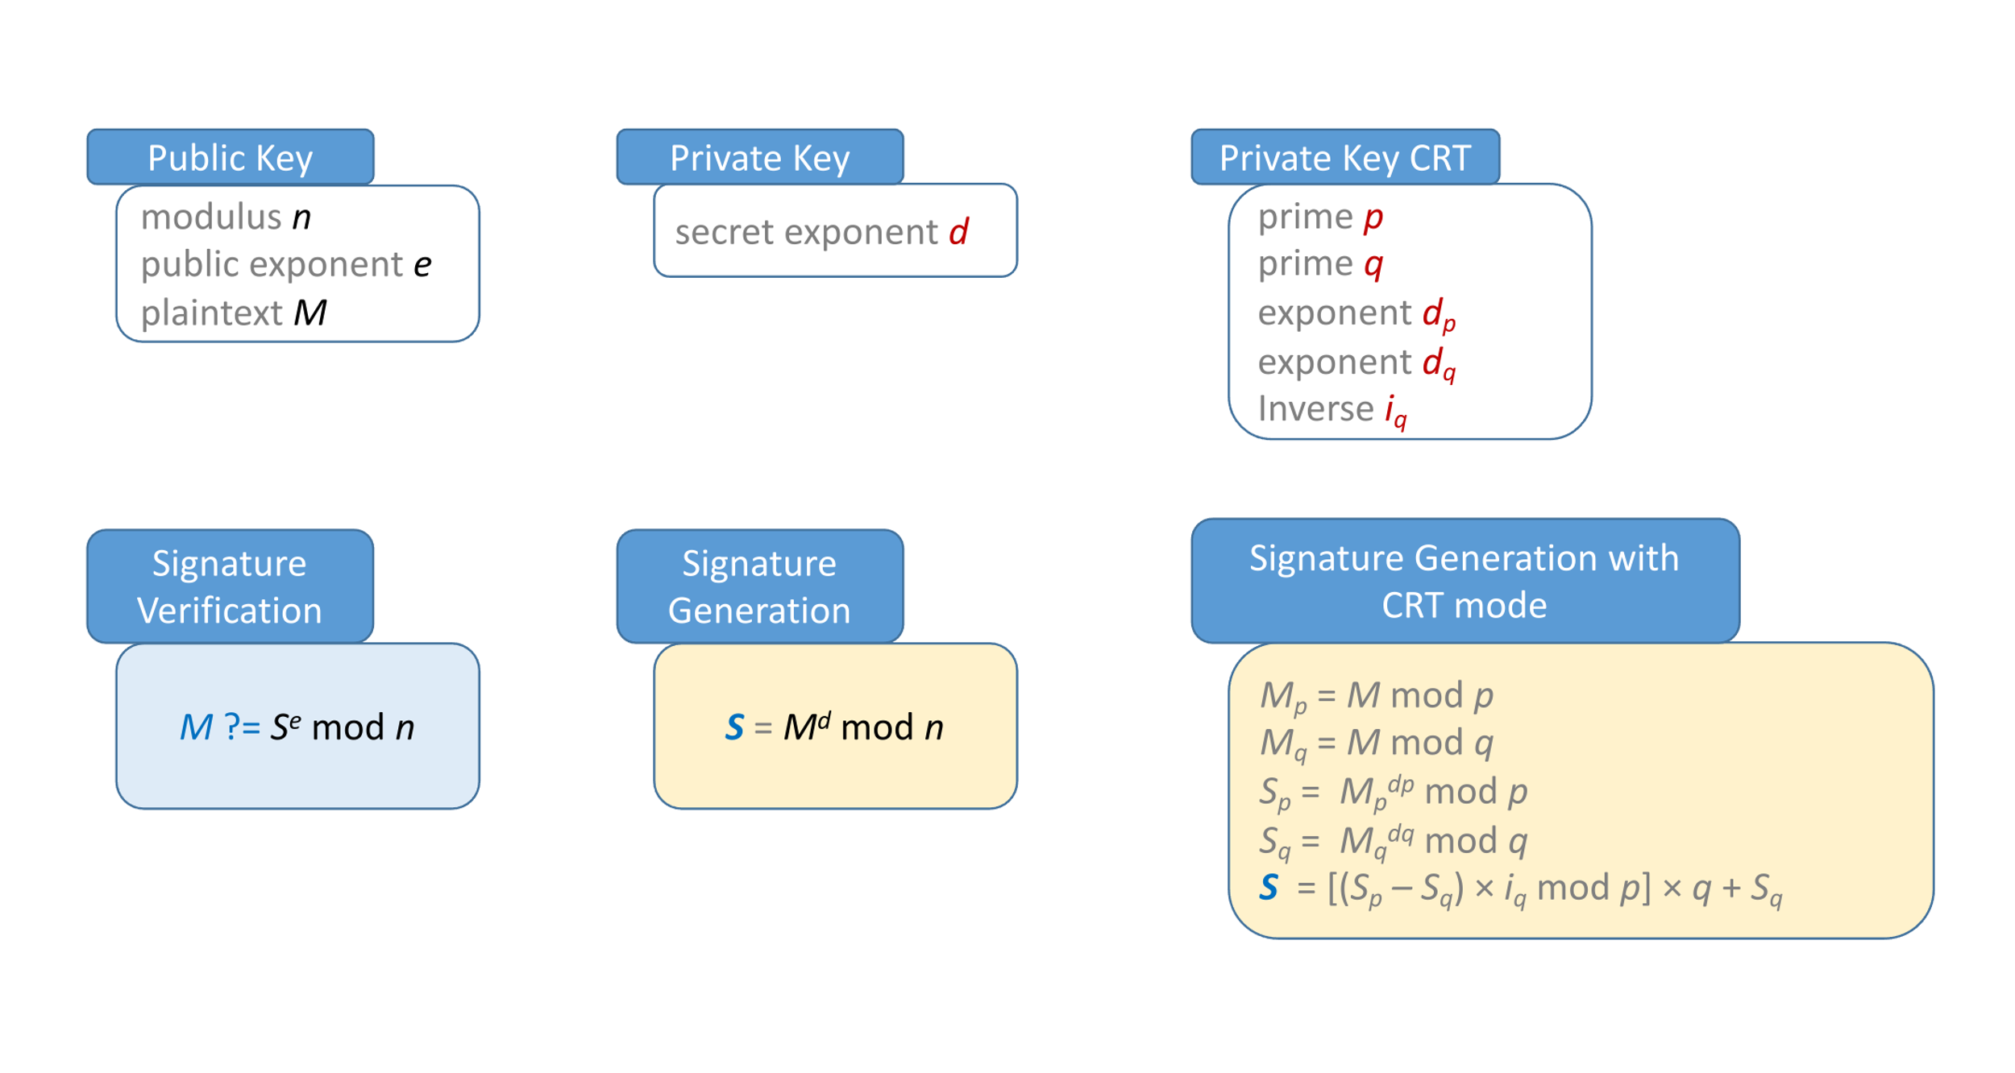
Remember RSA

Slide 34
Implementing RSA (and ECC)
CRT RSA: modular exponentiation M^{d} mod n is replaced by two exponentiations of half size.
As the complexity of this operation is in O(𝓵³) (with 𝓵 the bit-length of n) a half size exponentiation is 8 times faster.
The CRT-RSA is then theoretically about 4 times faster than the non-CRT exponentiation.
In practice, the efficiency gain will be closer to 3 than 4 due to the reduction and the recombination operations.
Most of the chip manufacturers include an arithmetic long integer accelerator, also said public key coprocessor, to compute modular multiplication operations more efficiently.
Depending on the manufacturer, the choice of the modular arithmetic can vary (i.e., Montgomery, Barrett, Quisquater).
It enables efficient implementations of RSA, CRT-RSA, DSA, DH schemes.
This coprocessor is also useful to implement efficient elliptic curves operations in ECDSA or ECDH schemes.

Slide 35
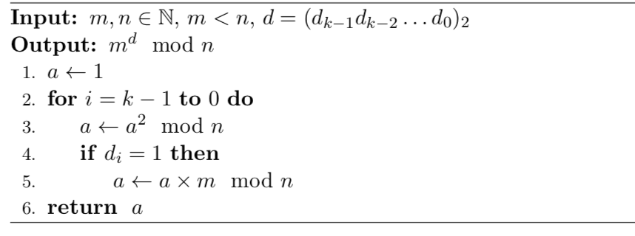
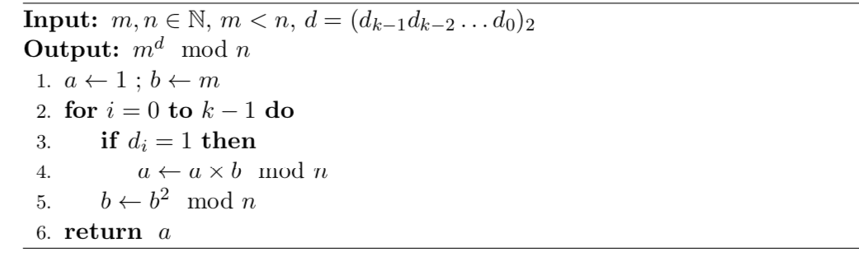
Classical Exponentiation Square and Multiply
Left-to-right Square-and-Multiply Exponentiation
Right-to-Left Square-and-Multiply Exponentiation

Slide 36
Modular Arithmetic Methods
The implementation of long integer efficient modular squaring and multiplication operations is of crucial importance for product makers.
Heavy constraints lie on these operations, especially in the context of embedded devices.
Several methods can be found in the literature. For instance, some common ones are the following:
Montgomery method
Barrett method
Quisquater method
Brickell method
Sedlak method
Scholar method (Knuth)
In practice the Montgomery and Barrett methods are the most efficient and most commonly used in most of the products.
Barrett, P. (1986). Implementing the Rivest Shamir and Adleman public key encryption algorithm on a standard digital signal processor. In Advances in Cryptology - CRYPTO '86, Santa Barbara, California, USA, 1986, Proceedings, pages 311-323.
Brickell, E. F. (1982). A fast modular multiplication algorithm with application to two key cryptography. In Advances in Cryptology: Proceedings of CRYPTO '82, Santa Barbara, California, USA, August 23-25, 1982, pages 51-60.
Knuth, D. E. (1997). The Art of Computer Programming, Volume 2 (3rd Ed.): Seminumerical Algorithms. Addison-Wesley Longman Publishing Co., Inc., Boston, MA, USA.
Montgomery, P. L. (1985). Modular multiplication without trial division. Mathematics of computation, 44(170):519-521.
Quisquater, J.-J. (1992). Encoding system according to the so-called RSA method, by means of a microcontroller and arrangement implementing this system. US Patent 5,166,978.
Sedlak, H. (1987). The RSA cryptography processor. In Advances in Cryptology - EUROCRYPT '87, Workshop on the Theory and Application of Cryptographic Techniques, Amsterdam, The Netherlands, April 13-15, 1987, Proceedings_, pages 95-105.

Slide 37
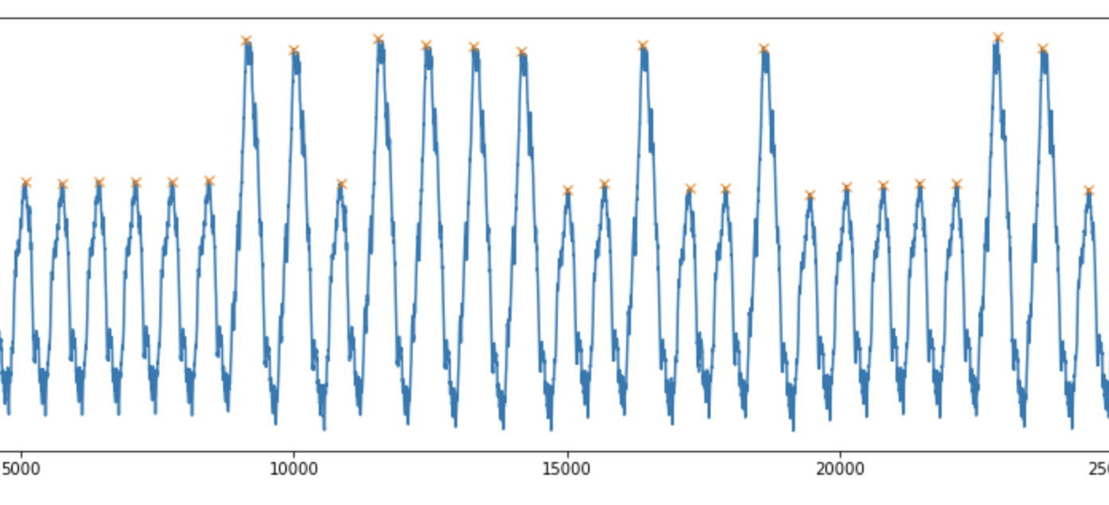
Simple Side Channel Analysis

Slide 38
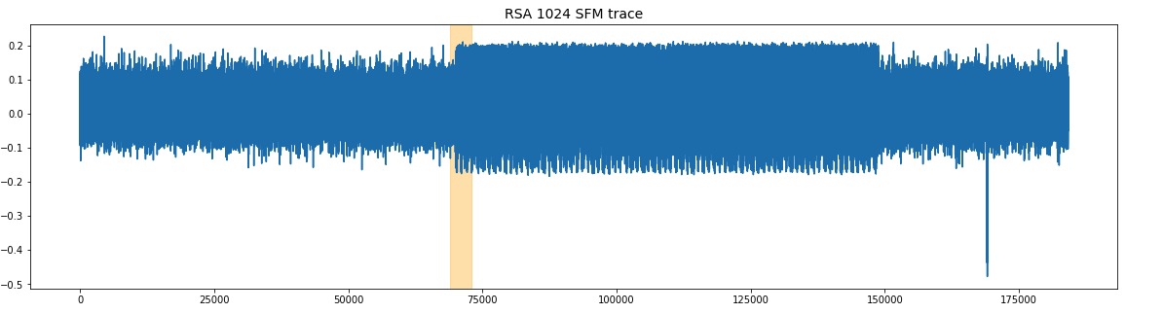
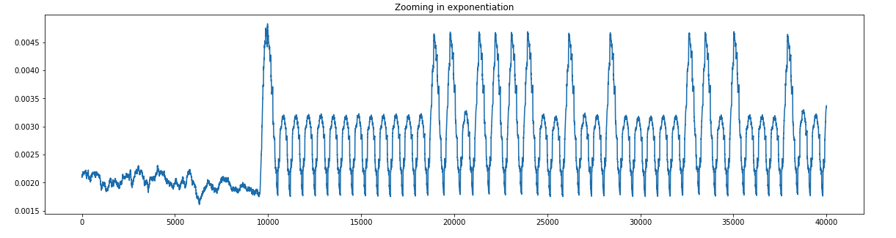
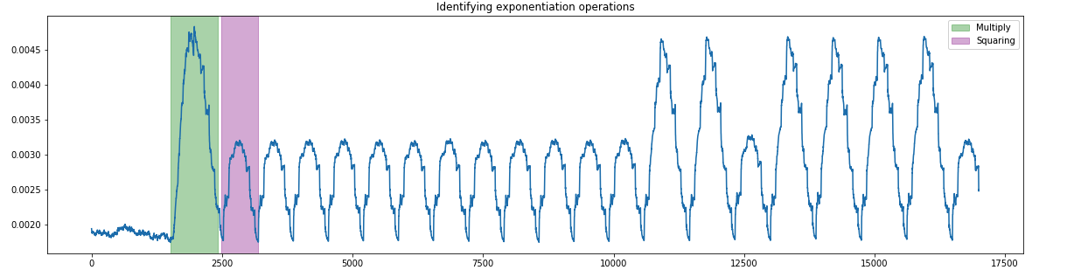
Demo/TP on SSCA on RSA challenge
See demo on RSA SSTIC challenge 2019
Without clustering
With clustering
https://scikit-leaxrn.org/stable/modules/clustering.html

Slide 39
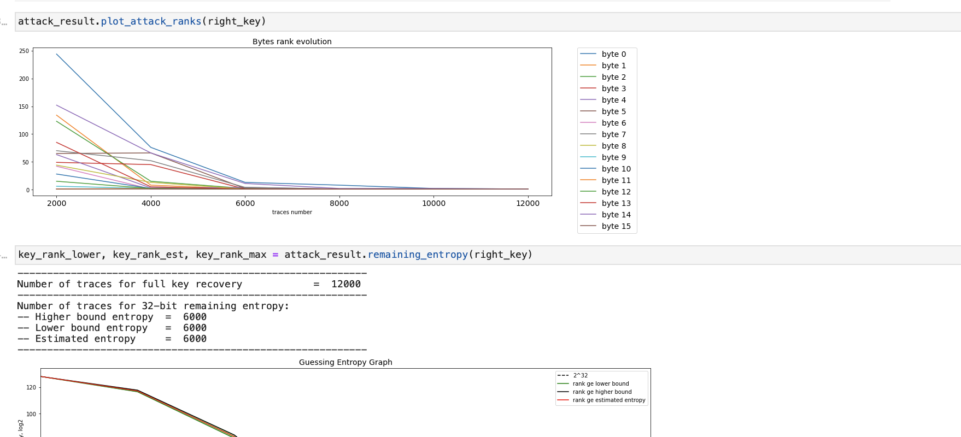
Differential Side Channel Analysis

Slide 40
Tools
Distinguisher
Statistical tool used to compare simulated set (from guess) and real traces set (from DUT)
DPA, CPA, SNR, NICV, MIA, ANOVA …
Discriminant:
Function to apply to sort the distinguisher resulting scores
Model:
Hamming weight, monobit, Hamming distance, value

Slide 41
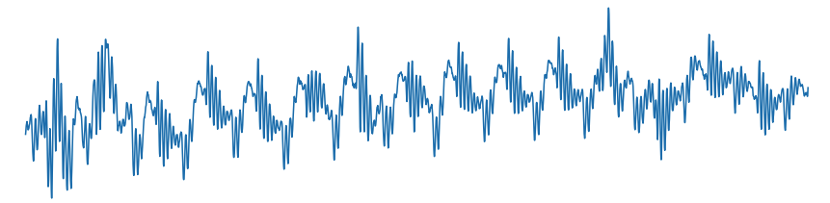
Differential Side-Channel Analysis
Run traces collection for cryptographic algorithm
Run E_{K} (encryption) of N plaintexts P₀ .. P_{N-1} store related side-channel traces C₀ .. C_{N-1}.
…
C₀ = E_{K}(P₀) C_{N-1} = E_{K}(P_{N-1})

Slide 42
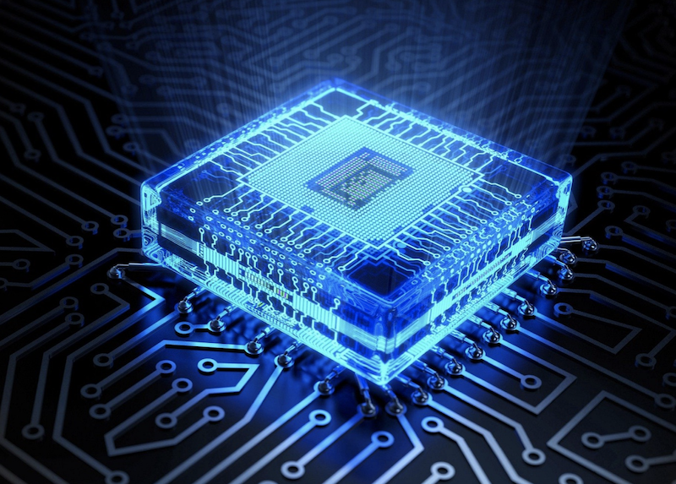
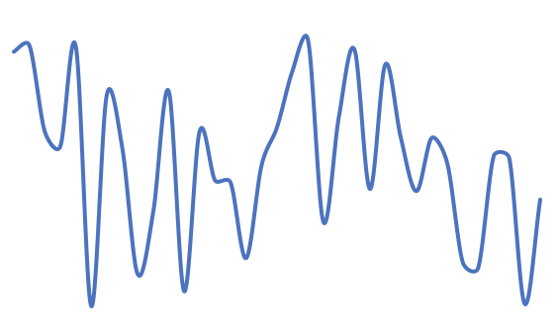
Side-Channel Analysis
Plaintext₀
Ciphertext₀
Plaintext₁
Ciphertext₁
Plaintext₂
Ciphertext₂
Plaintext₃
Ciphertext₃
Plaintext_{N-1}
Ciphertext_{N-1}

Slide 43
Differential Side-Channel Analysis
Apply Divide-and-Conquer method on the operations and involved key-bits
Guess 𝛌 bit of key chunk: for instance, 6-bit for TDES SBoxes, 8-bit for AES ByteSub
Break down the problem = full key recovery to sub-problem = recover key per bit-chunk involved in sub operations
Define the computation targeted
Selection function = KeyAddition Substitution …. In first or last rounds

Slide 44
Selection Function Key Byte 0
P₀
P₁
…
P₁₄
P₁₅
⊕
Selection function output K₀
K₀
K₁
…
K₁₄
K₁₅
256
SuBbytes
n plaintexts
P₀
P₁
…
P₁₄
P₁₅
Guess 0
Guess 1
Guess 255

Slide 45
Selection Function Key Byte 0
P₀
P₁
…
P₁₄
P₁₅
Plaintext 0
⊕
00
K₁
…
K₁₄
K₁₅
256
SuBbytes
0x1C
n plaintexts
1C
P₁
…
P₁₄
P₁₅
Guess 0
Guess 1
Guess 255

Slide 46
Selection Function Key Byte 0
P₀
P₁
…
P₁₄
P₁₅
Plaintext 1
⊕
00
K₁
…
K₁₄
K₁₅
256
SuBbytes
0x1C
0x8A
n plaintexts
8A
P₁
…
P₁₄
P₁₅
Guess 0
Guess 1
Guess 255

Slide 47
Selection Function Key Byte 0
P₀
P₁
…
P₁₄
P₁₅
Plaintext n-1
⊕
00
K₁
…
K₁₄
K₁₅
256
SuBbytes
0x1C
…
0x8A
n plaintexts
73
P₁
…
P₁₄
P₁₅
0x73
Guess 0
Guess 1
Guess 255

Slide 48
Selection Function Key Byte 0
P₀
P₁
…
P₁₄
P₁₅
Plaintext 0
⊕
01
K₁
…
K₁₄
K₁₅
256
SuBbytes
0x1C
0xAB
…
0x8A
n plaintexts
AB
P₁
…
P₁₄
P₁₅
0x73
Guess 0
Guess 1
…
Guess 255

Slide 49
Selection Function Key Byte 0
P₀
P₁
…
P₁₄
P₁₅
Plaintext 1
⊕
01
K₁
…
K₁₄
K₁₅
256
SuBbytes
0x1C
0xAB
…
0x8A
0x12
n plaintexts
12
P₁
…
P₁₄
P₁₅
0x73
Guess 0
Guess 1
…
Guess 255

Slide 50
Selection Function Key Byte 0
P₀
P₁
…
P₁₄
P₁₅
Plaintext n-1
⊕
01
K₁
…
K₁₄
K₁₅
256
SuBbytes
0x1C
0xAB
…
…
0x8A
0x12
n plaintexts
F1
P₁
…
P₁₄
P₁₅
0x73
0xF1
Guess 0
Guess 1
…
Guess 255

Slide 51
Selection Function Key Byte 0
P₀
P₁
…
P₁₄
P₁₅
Plaintext n-1
⊕
FF
K₁
…
K₁₄
K₁₅
256
SuBbytes
0x1C
0xAB
0x23
…
…
…
0x8A
0x12
0x9D
n plaintexts
87
P₁
…
P₁₄
P₁₅
0x73
0xF1
0x87
Guess 0
Guess 1
…
Guess 255

Slide 52
Selection Function
256
256 × n
Key byte 15
256 × n
Key byte 0
n plaintexts
16
Guess 0
Guess 1
…
Guess 255

Slide 53

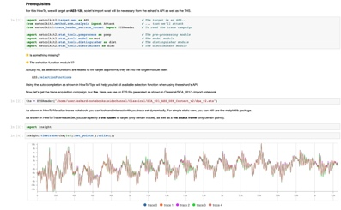
Now use a distinguisher …
256
…
…
…
n plaintexts
n traces
Simulated Data from guesses
Measurement Data
Guess 0
Guess 1
…
Guess 255

Slide 54
Differential Side-Channel Analysis DPA for Differential Power Analysis
256
Set G₀
Set G₁
…
0x1C
…
…
n plaintexts
Guess 0
Guess 1
…
Guess 255
Model
MonobitMsb(0)
Partitioning
0

Slide 55
Differential Side-Channel Analysis DPA for Differential Power Analysis
256
…
Set G₀
…
Set G₁
…
0x1C
…
…
0x8A
n plaintexts
Guess 0
Guess 1
…
Guess 255
Model
MonobitMsb(0)
Partitioning
1

Slide 56
Differential Side-Channel Analysis DPA for Differential Power Analysis
256
…
Set G₀
…
Set G₁
…
0x1C
…
…
0x8A
n plaintexts
0x73
Guess 0
Guess 1
…
Guess 255
Model
MonobitMsb(0)
Partitioning
0

Slide 57
Differential Side-Channel Analysis DPA for Differential Power Analysis
Bit 0 Set
Bit 1 Set

Slide 58
Side-Channel Analysis
Bit 0 Set
Bit 1 Set
Average traces

Slide 59
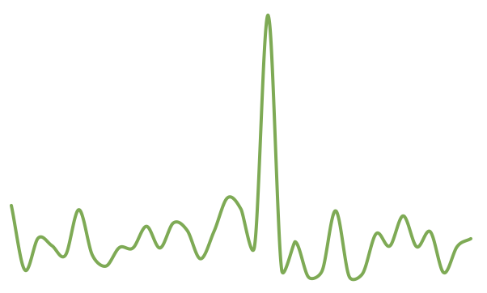
Side-Channel Analysis
Wrong assumption
Good assumption
,
,

Slide 60
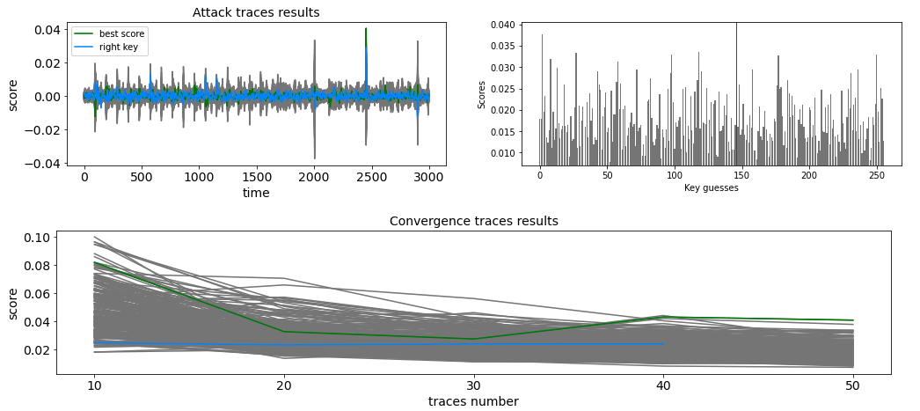
Differential Side-Channel Analysis Not always efficient technique
Correct Guess
Wrong Guess
Here DPA is not efficient with this number of traces !!!
HOW CAN WE IMPROVE?

Slide 61
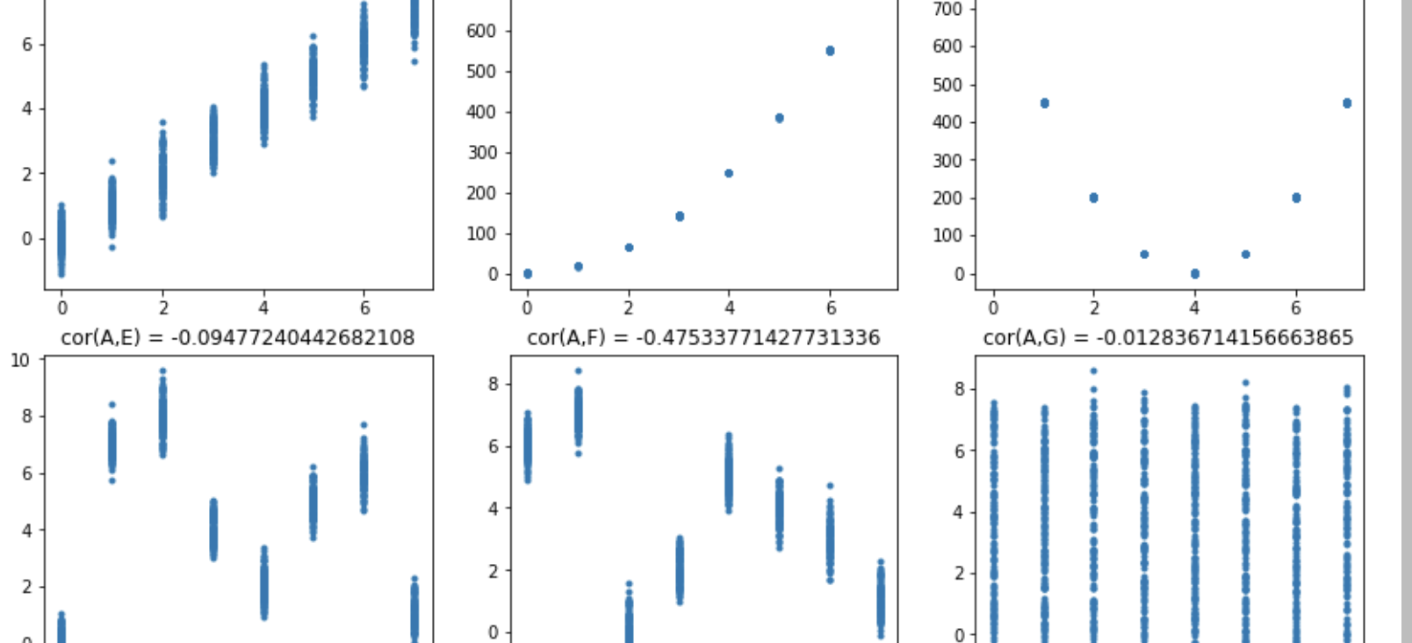
Correlation Side Channel Analysis The first break event since 1998.

Slide 62
Correlation Power Analysis
Bravais-Pearson Correlation Factor can be used to measure the statistical dependency between two set of data
Linear Regression
Remember we have the following two sets: we want to evaluate if they are “closed”
Measurement Data
Simulated Data from guesses

Slide 63
Correlation Power Analysis
Two variables (data sets) are linearly related
→ the correlation coefficient will be high
If the two data sets are not linearly related
→ the correlation coefficient will be low.
Most cases have shown Linear leakage model in Hamming weight is efficient
Model:
W = a × HW(data) + b + noise

Slide 64
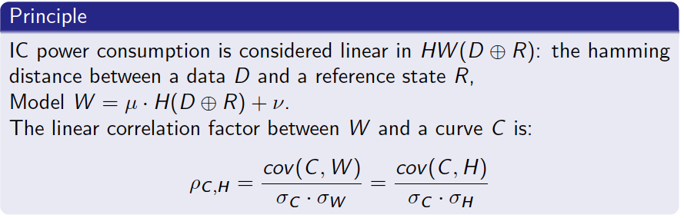
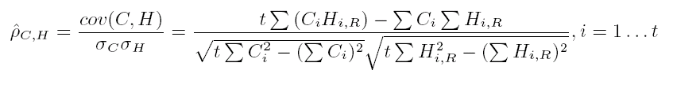
Correlation Power Analysis

Slide 65
Now use Correlation Analysis
256
…
…
…
n plaintexts
n traces
Simulated Data from guesses
Measurement Data
Guess 0
Guess 1
…
Guess 255

Slide 66
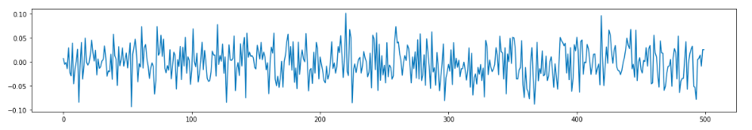
Now use Correlation Analysis
256
W₀
Correlation
(W₀ , C)
n plaintexts
C
Guess 0
Guess 1
…
Guess 255

Slide 67
Now use Correlation Analysis
256
W₁
Correlation
(W₁ , C)
n plaintexts
C
Guess 0
Guess 1
…
Guess 255

Slide 68

Now use Correlation Analysis
256
W_{K}
Correlation
(W_{K} , C)
n plaintexts
C
Guess 0
Guess 1
…
Guess 255

Slide 69
Now use Correlation Analysis
256
W₂₅₅
Correlation
(W₂₅₅ , C)
n plaintexts
C
Guess 0
Guess 1
…
Guess 255

Slide 70

Correlation Attack Result

Slide 71
Correlation Power Analysis
We can use information from all bits contrarily to DPA – no information loss
All operand and values can be used with
Mono-bit attacks
Hamming weight attack
Value itself to be correlated
This model is linear in the HW or HD
But it is close to the real behaviour of a circuit
Indeed, the Hamming measures the number of bit flips entre between a state i and the next state i+1
Example: writing in a register R0
R0 = a
R0 ← R0 ⊕ K
R0 = b Bit flip a ⊕ b → K
Requires about 10 times less traces than DPA; no “ghost” peaks

Slide 72
CPA demonstrations on DES and AES
DPA vs CPA on XMEGA AES Traces
DSCA on DES DPA contest V1
DSCA on AES DPA contest V2

Slide 73
Categories of Countermeasures
Protocol
Paddings
Session keys,
Fresh re-keying
Unknown input and/or output (partially): CTR mode, payment ATC
Desynchronize
Hardware de-synchronization: jitter, clock and frequency jitters, random delays
Shuffling
One amongst N techniques
De-correlate
Hardware techniques to balance consumption (dual rail)
Masking techniques

Slide 74
One among N countermeasure(s)
AES
AES
…
AES
AES
AES
AES
…
AES
AES
AES
…
AES
AES
DES
DES
…
AES
AES
AES
…
AES
AES
DES
DES
…
AES
AES
AES
AES
…
AES
…
AES
AES
…
AES
AES
…
AES
AES
AES
AES
…
AES

Slide 75
One among N countermeasure(s)
AES
AES
…
AES
AES
AES
AES
…
AES
AES
AES
…
AES
AES
DES
DES
…
AES
AES
AES
…
AES
AES
DES
DES
…
AES
AES
AES
AES
…
AES
…
AES
AES
…
AES
AES
…
AES
AES
AES
AES
…
AES
Same input message with fake keys
Different (random fake input) messages for correct key: key is manipulated more (!!)

Slide 76
Attacking: one among N countermeasure(s)?
AES
AES
…
AES
AES
AES
AES
…
AES
AES
AES
…
AES
AES
AES
AES
…
AES
AES
AES
…
AES
AES
AES
AES
…
AES
AES
AES
AES
…
AES
…
AES
AES
…
AES
AES
…
AES
AES
AES
AES
…
AES
Same input message with random fake keys
What attack do you recommend?
Ghost peaks?

Slide 77
Attacking one among N countermeasure(s)?
AES
AES
…
AES
AES
AES
AES
…
AES
AES
AES
…
AES
AES
DES
DES
…
AES
AES
AES
…
AES
AES
DES
DES
…
AES
AES
AES
AES
…
AES
…
AES
AES
…
AES
AES
…
AES
AES
AES
AES
…
AES
Same input message with random fake keys
What attack do you recommend? Ghost peaks?
Cipher texts attacks are more efficient

Slide 78
Masking Techniques
Data Masking with random values
The idea
Ai ⊕ K = Bi can be attacked with DPA..
Use a random X and replace by
Ai ⊕ X = Ci
Ci ⊕ K = Di
Di ⊕ … → Ei
Ei ⊕ X = Bi
The bit-flips and IC power consumption changes at each execution
Several countermeasures based on this principle published
Can be Boolean (TDES, AES) and/or arithmetic masking (HMAC)

Slide 79
AES first operations
P₀
P₁
…
P₁₄
P₁₅
⊕
K₀
K₁
…
K₁₄
K₁₅
SuBbytes
A₀
A₁
…
A₁₄
A₁₅

Slide 80
Selection Function Key Byte 0
P₀
P₁
…
P₁₄
P₁₅
⊕
Selection function output K₀
K₀
K₁
…
K₁₄
K₁₅
256
SuBbytes
n plaintexts
P₀
P₁
…
P₁₄
P₁₅
Guess 0
Guess 1
Guess 255

Slide 81
Selection Function Key Byte 0
P₀
P₁
…
P₁₄
P₁₅
Plaintext 0
⊕
00
K₁
…
K₁₄
K₁₅
256
SuBbytes
0x1C
n plaintexts
1C
P₁
…
P₁₄
P₁₅
Guess 0
Guess 1
Guess 255

Slide 82
Selection Function Key Byte 0
P₀
P₁
…
P₁₄
P₁₅
Plaintext 1
⊕
00
K₁
…
K₁₄
K₁₅
256
SuBbytes
0x1C
0x8A
n plaintexts
8A
P₁
…
P₁₄
P₁₅
Guess 0
Guess 1
Guess 255

Slide 83
Selection Function Key Byte 0
P₀
P₁
…
P₁₄
P₁₅
Plaintext n-1
⊕
00
K₁
…
K₁₄
K₁₅
256
SuBbytes
0x1C
…
0x8A
n plaintexts
73
P₁
…
P₁₄
P₁₅
0x73
Guess 0
Guess 1
Guess 255

Slide 84
AES
P₀
P₁
…
P₁₄
P₁₅
⊕
K₀
K₁
…
K₁₄
K₁₅
SubBytes
A₀
A₁
…
A₁₄
A₁₅

Slide 85
AES side-channel masking
P₀
P₁
…
P₁₄
P₁₅
⊕
R
R
…
R
R
⊕
K₀
K₁
…
K₁₄
K₁₅
SubBytes
Select random mask R
SR, MixColumn are linear, easy to mask and unmask
F(A ⊕ R ) = F(A) ⊕ F(R)
SubBytes is not linear, more complex operation
SubBytes(A ⊕ R ) ≠ SubBytes(A) ⊕ SubBytes(R)
A₀ ⊕ ?
A₁⊕ ?
…
A₁₄⊕ ?
A₁₅⊕ ?
How to protect the SubBytes ?

Slide 86
AES side channel masking
P₀
P₁
…
P₁₄
P₁₅
⊕
R
R
…
R
R
⊕
K₀
K₁
…
K₁₄
K₁₅
SuBbytes*
for value from 0 to 255
SubByte_Masked [value ⊕R] = SubByte[value ] ⊕ R
A₀ ⊕ R
A₁⊕ R
…
A₁₄⊕ R
A₁₅⊕ R
ShiftRow
Repeat on all Rounds
…
→ then unmask!
MixColumn
B₀ ⊕ R
B₁⊕ R
…
B₁₄⊕ R
B₁₅⊕ R

Slide 87
More …
Can be done similarly on T table implementation of AES
Bigger tables require more memory
Faster

Slide 88

High Order Side-Channel Analysis

Slide 89
Second (Higher) Order Attacks
Find two instants on the trace where:
i₁: the mask R is manipulated
I₂: target data D masked with R is manipulated
R ⊕ (D ⊕ R) = D
HW(R) ⊕ HW(D ⊕ R) ≠ HW(D)
HW(R) ⊕ HW(D ⊕ R) ≈ HW(D)
i₁ : R
i₂ : D ⊕ R

Slide 90
Reminder on Second order attacks
2nd Order Attack Principle:
Find two instants i₁ and i₂ on the trace(s) where the mask R is manipulated
Combine those two instants i₁ and i₂ to remove the mask influence
Perform classical 1st order attack
Method 1: Combine i₁ and i₂ with Absolute Difference :
T* = abs(i₁ – i₂)
Correlation (T*, guesses)
Method 2: Combine i₁ and i₂ with Normalised (Centered) Product
E₁ the mean of i₁ and E₂ the mean of i₂
T* = (i₁ - E₁)*(i₂ - E₂)
Correlate (T*, selection_function_values)

Slide 91
More second order attacks
Can be difficult to locate R
Combine SubBytes(P₀⊕R) with SubBytes(P₁⊕R)
Requires 2¹⁶ guesses instead of 2⁸
Combine Round-1- SubBytes(P₀⊕R) with Round-10-SubBytes(P₀⊕R)
Requires 2¹⁶ guesses instead of 2⁸
…

Slide 92
Second Order Attack Demonstration
See notebook demonstration on second order attack.

Slide 93
How to improve resistance
Diversify the masks
One random mask per byte on linear operations
Change mask at each round
Easy to handle for ShiftRow and MixColumn
One random byte per SubByte operation in the round
Requires 16 masked new SubBytes
Add Shuffling: random order execution
Mainly on SubBytes operations
Add one AES among N countermeasure
Implement SubBytes differently
Can perform inversion in GF(16) instead of GF(256)
Smaller table, more masks, more permutations
Implement the inversion in GF(256) and mask the operation with a combination of multiplicative (additive and Boolean masking)
It will make the second order attack theoretically possible but more complex to perform in practice

Slide 94
Obscurity
Not Kerckhoffs’s principle:
“A cryptosystem should be secure even if everything about the system, except the key, is public knowledge.”
Shannon
”one ought to design systems under the assumption that the enemy will immediately gain full familiarity with them”
Can help against side-channel if added on top of standard crypto algorithm
Not a countermeasure “recommended”
P
AES
Key K
H

Slide 95
Infective Computation
Add integrity or MAC
If not correct execute but with fake key instead of correct one
Make the attacker losing time on fake data
Attacker must not detect the key is fake (you detected him)

Slide 96


Multiplicative Masking Technique
Several countermeasures (publication) involve multiplicative masking
Boolean mask is now multiplicative
Inversion gives:
Not sensitive to high order attacks
Sensitive to ZERO VALUE attacks

Slide 97
d^{th} order resistant implementations
Split the data D and key K to be protected into d+1 random shares to prevent the product from d^{th} high order side-channel attacks.
The principle is the following:
Generate d random values r₁, …, r_{d}
Generate d random values k₁, …, k_{d}
Compute r₀ = D ⊕ r₁ ⊕ …⊕ r_{d}
Compute s₀ = K ⊕ s₁ ⊕ …⊕ s_{d}
D ⊕ K = (r₀ ⊕ s₀) ⊕ (r₁ ⊕ s₁) ⊕ … ⊕ (r_{d} ⊕ s_{d})

Slide 98
d^{th} order resistant implementations
ISW (Ishai – Sahai – Wager) scheme
Y. Ishai, A. Sahai, and D. Wagner. Private Circuits: Securing Hardware against Probing Attacks. In D. Boneh, editor, Advances in Cryptology – CRYPTO 2003,
AND and NOT gates circuit
M. Rivain and E. Prouff
Provably Secure Higher-Order Masking of AES. CHES 2010
L. Goubin and A. Martinelli
Protecting AES with Shamir’s Secret Sharing Scheme. CHES 2011.

Slide 99

Fresh Rekeying
Provide side-channel resistance by
limiting the side-channel attacks paths as different keys are used in the computations.
Re-Keying can be done externally via the protocol or internally.
We focus here on internal Re-Keying.
designing a function g to re-key a block cipher f
with a master and constant values with a random nonce r.
Then each encryption of a plaintext block is performed with a fresh key k*
such that the ciphertext is c = f_{k*}(p).
It can also be decided to relax the model and to use a fresh key
for a given number w of plaintext blocks encryptions
ensuring the number L is small enough to prevent the TOE from profiled and not profiled attacks.
Make use of functions more resistant to side-channel than others …

Slide 100


Tree Key

Slide 101

Real Example in Secure Boot

Slide 102

Back to RSA

Slide 103


How to protect RSA from SSCA .. Use an atomic exponentiation
Squaring and multiplication are done using the same operation Multiply Always exponentiation
Previous simple analysis is not efficient anymore.

Slide 104


… Or with Regular Implementations

Slide 105
… Not enough to prevent DSCA …
See demo notebook for DSCA on Exponentiation

Slide 106
Blinding
Multiplicative message blinding
M* = r^{e} mod N r a large random value, e the public exponent
Additive message blinding
M* = M + r₁.N mod r₂.N r₁, r₂ large random values

Slide 107
There are still possible attacks
Cross Correlation
Distinguishing Squaring from Multiplying operations
The Doubling (Squaring) Attack

Slide 108
Add the exponent blinding countermeasure
Euclidean division exponent blinding
d = r.d₁ + d₂ r a large random value > 128 bits
→ M^{d} = (M^{r})^{d1} × M^{d2} mod N
Additive exponent blinding
d* = d + r.𝛗(N) r a large random value > 128 bits, 𝛗 the Euler function
Exponent split
d₁ = d – r r a large random value > 128 bits
→ M^{d} = M^{d1} × M^{r} mod N

Slide 109

Combining Several Countermeasures
Example combining:
Atomic exponentiation
Additive message blinding
Additive exponent blinding

Slide 110
Single Trace Attack on blinded RSA with Clustering techniques
See demo on RSA SMA
With clustering
https://scikit-leaxrn.org/stable/modules/clustering.html

Slide 111

Side-Channel Methodology

Slide 112
Side Channel Methodology
Tests Plan
Observe
Collect
Align
Characterize
Attack
Analyse and decide
Measure

Slide 113

Side Channel Attacks Methodology Step 1: Tests Plan
Evaluation mode
Knowledge on the product is given for the evaluation
Source code, IC design, cryptographic operations and IPs, etc.
information given
Vulnerability Analysis
Identify potential attack if information available
Test Plan
Define tests based on Vulnerability Analysis if it was performed.

Slide 114
Side Channel Attacks Methodology Step 2: Measurement
Measurement set-up
Setup the measurement
Select probe, location
Sampling rate,
EM (preferably often)
Triggering
Identify the operation you are targeting
Find the best signal for the operation
targeted,
Cartography can help

Slide 115
Side Channel Attacks Methodology Step 3: Locate / Process with Few traces Observation
What is the knowledge you can get to locate and identify?
Observe the trace
What can you identify?
Seeing the algorithm rounds? rounds operation?
Chosen input
Depending on the leakage model of the device for the targeted operation, fixing a certain number of bytes to a constant (i.e., 0) can make appear specific patterns in the trace to locate the interesting area in the trace or even to recover secret.
Signal Processing
Apply signal processing techniques to observe potential loops, identify better the operations related to the computations
Investigate better signal processing that will be helpful for aligning the traces once collected

Slide 116
Side Channel Attacks Methodology Step 4: Collect traces
Define setup
Sampling to use
Define Area to collect in the computation for the chosen attack path
(first or last rounds for example)
Setup for trace collection
Run the traces collection
Collect traces and store
100K? 1M? 10M?
Efficient equipment required (up to 1M per day)

Slide 117
Side Channel Attacks Methodology Step 5: Align
Alignment
Identify which signal processing techniques to combine to align traces
Run the alignment(s)
Critical Path
Alignment can determine the success or failure of the attacks
Major part of the global effort

Slide 118
Example: observe then align
See observation notebook on aligned and not aligned traces

Slide 119

Side Channel Attacks Methodology Step 5: Characterize
What is the knowledge you can get to characterize?
Input – Output
Knowing the computation input and/or output (plaintext or ciphertext) can help
Perform SCA tests on input to locate the beginning of the targeted operation in the trace(s)
Perform SCA tests on output to locate the end of the targeted operation in the trace(s)
Require a first traces collection to be done
Chosen input → TVLA Test Vector Leakage Assessment i.e., T-test …
You can select specific values as input to get more knowledge on the operations and find leakages points, T test
Fixing a certain number of bytes to a constant (i.e., 0) can reduce the algorithmic noise from one operation on the targeted one
Depending on the leakage model of the device for the targeted operation, fixing a certain number of bytes to a constant (i.e. 0) can make appear specific patterns in the trace to locate the interesting area in the trace or even to recover secret.

Slide 120
Side Channel Attacks Methodology Step 6: Characterize
What is the knowledge you can get to characterize?
Key Knowledge → Leakage Detection on Data Computation with Key Knowledge
Knowing the key means you can characterize your implementation (at each step, each round)
You can test to correlate each intermediate value of the computation with the trace
Answer: YES there is leakage in the implementation → might lead to an attack exploitation
Answer: NO there is no obvious leakage in the implementation
Chosen Key→ Leakage Detection on Key Manipulation with Key Knowledge
Knowing the key allows to characterize the key schedule (T-test, reverse with varying keys)
Can be used to build templates on the key manipulation
Characterization results provide first test conclusion.

Slide 121

Side Channel Attacks Methodology Step 7: Attack
Run the attacks
Test different leakages models
Test all selection functions
Log results
Observe results
Can use thresholds to sort the result at a first stage
score value higher to a threshold
Ratio between best score and next higher ones.
Use characterization results to run appropriate attacks
Tests related attack paths
(model, selection functions..)
Log results
Observe results coherency with characterization
No characterization knowledge
With characterization knowledge

Slide 122
Side Channel Attacks Methodology Step 8: Analyse and Decide
Conclude on testing and evaluation
Or relaunch different tests if there is a plan.

Slide 123
Welsch t-test
Most used test is the student T-test
Requires the evaluator can send chosen messages
Using random and fix plaintext sets
Variance based test
Identify 1st order leakages
Can be turned to higher order leakages detection

Slide 124



TVLA and t test
The initial publication dealing with using the Welch's t test for TVLA is the following one in 2008:
https://csrc.nist.gov/csrc/media/events/non-invasive-attack-testing-workshop/documents/08_goodwill.pdf

Slide 125
Welsch t test
T-test examines the leakage of the Device Under Test (DUT) independent of its underlying architecture.
Gives a level of confidence to conclude that the DUT has an exploitable leakage or not.
However, it provides no information
about the easiness/hardness of an attack which can exploit the leakage,
nor about an appropriate intermediate value and the hypothetical model.
Can easily and rapidly report that the DUT fails to provide the desired security level:
e.g., due to a mistake in the design engineering
or a flaw in the countermeasure.
T-test analysis requires to acquire at least two (better more) sets of traces:
Set A provides random data
Set B provides fix or semi-fix data
The targeted data could be any of the algorithm inputs (plaintext, key, mask ...).
[GJJR] G. Goodwill, B. Jun, J. Jaffe, P. Rohatji - A testing methodology for side-channel resistance validation. https://csrc.nist.gov/csrc/media/events/non-invasive-attack-testing-workshop/documents/08_goodwill.pdf
[SM15] Tobias Schneider and Amir Moradi. Leakage Assessment Methodology - a clear roadmap for side-channel evaluations. CHES-2015 - https://eprint.iacr.org/2015/207.pdf
[BCDJKKLMRS] G. Becker, J. Cooper, E. DeMulder, G. Goodwill, J. Jaffe, G. Kenworthy, T. Kouzminov, A. Leiserson, M. Marson, P.Rohatgi and S. Saa. Test Vector Leakage Assessment (TVLA) methodology in practice

Slide 126

t test

Slide 127

TP of t-test on AES
See demo/TP notebook on AES

Slide 128


Attack and Remaining Key Entropy
How to evaluate the results of a side-channel attack
Do we really need the full key to be recovered?
Remaining entropy is the right cursor !
https://eprint.iacr.org/2014/920.pdf

Slide 129

Cryptographic Protocol vs.. Cryptographic Algorithm … Sometimes there is still space somewhere around the algorithm for something different☺

Slide 130
Side-Channel Attack on the MAC Algo3 2015 (only…)
Developers MUST prevent their product from side-channel attacks
First and higher order(s)
Cryptographic engineers develop strong DES and AES
These algorithms are used in protocols
Weakness can be in the protocol
MAC Algo3 is an ISO protocol
DES CBC chaining mode
End with a TDES operation

Slide 131

MAC Algo3

Slide 132

MAC Algo3

Slide 133

Side-Channel Attack on MAC Algo3
Set P₁ to constant, i.e. 0
Execute MA3
with random values for P₂: P_{2,0} to P_{2,n}
Collect execution traces C₀ … C_{n}
Perform CPA on P₂ xor C₁
C₁ = DES(0, K₁)
Recover the value C₁
Brute force C₁ and recover K₁
Brute force MAC and recover K₂.

Slide 134

Attack Result

Slide 135
Today? More and more side-channel attacks in real life.

Slide 136



Side-channel
Target any Kind of Integrated Circuit
Smartcards, Secure Elements, FPGA, SoC FPGA, complex SoC in mobiles, computers …
Nvidia Tegra 2 SoC

Slide 137






Wide Range of Products Nowadays
Smart cards: contact, contactless or dual interface
RFID Tags
Tokens, USB keys, SSD secure storage
Set-top-Box
FPGAs
Systems on Chips (SoC)
Mobile Phone
Military Products

Slide 138

Attack categories
Measurement: power, RF, EM
Timings Attacks
Simple Side-Channel Analysis
Differential Side-Channel Analysis
Advanced Side-Channel Attacks:
Horizontal,
High Order
Profiled vs. Not Profiled Attacks
Template Attacks
Deep Learning
Example of side-channel attack classification proposed in:
Systematic Classification of Side-Channel Attacks: A Case Study for Mobile Devices Raphael Spreitzer, Veelasha Moonsamy, Thomas Korak, and Stefan Mangard

Slide 139




Open Sources
Lascar https://donjon.ledger.com/about/
Scared https://github.com/eshard/scared
Side-Channel marvels: https://github.com/SideChannelMarvels
REASSURE project https://reassure.eu
SCALib https://github.com/simple-crypto/SCALib
Languages:
From C, C++, Matlab, Maple
to Python, Numpy, Scipy, Jupyter Lab, Julia, Sage

Slide 140


A side journey to Titan
https://ninjalab.io/a-side-journey-to-titan

Slide 141

2024: EUCLEAK

Slide 142


ECDSA secret key recovery from partial scalar leakage
From full scalar k recovery the secret key d can be recovered with:
It might happen only few bits of k are recovered: d can not be recovered with this formula.
It is still possible when several consecutive bits of the scalar are recovered for several ECDSA signatures to recover d using lattices reduction.
See papers below.
Fig. from [Poussier et al.]

Slide 143

SideLine attacks
https://eprint.iacr.org/2020/1127.pdf
REMOTE side channel attack on device !
And also now remote fault attack on devices.

Slide 144

Post Quantum Cryptography

Slide 145

https://quantumpedia.uk/a-brief-history-of-quantum-computing-e0bbd05893d0

Slide 146
(Pre-Quantum) Cryptography : TODAY
Cryptography | Algorithms | Strength
Symmetric | AES-128 /AES-192 / AES-256 AES-GCM Chacha20 HMAC-SHA-256. Poly1305 SHA-2 / SHA-3 / Salsa20 | 2¹²⁸ to 2²⁵⁶
Asymmetric | RSA / DSA 2048-4096 ECDH / ECDSA P-256 / P-521 ECIES - EdDSA | 2¹²⁸ to 2²⁵⁶

Slide 147


Schor’s algorithm
1994 Schor designed quantum algorithm
Capable to solve big integer factorization and discrete logarithm resolution mathematical problem in polynomial time compared to GNFS that is sub-exponential time.
RSA, DH, DSA, ECDH, ECDSA security defeated when quantum computers with sufficient qubits allows Schor’s algorithm execution.

Slide 148

Grover’s algorithm
1996 Grover designed quantum algorithm to speed up symmetric cryptography algorithm key recovery
Offering a quadratic speedup compared to classical algorithms, which require approximately N steps.
Grover’s algorithm is less dramatic than that of Shor’s algorithm, it still demonstrates the potential of quantum computing to outperform classical computing in specific tasks..

Slide 149

Quantum Computer is coming … Quantum Computer is there?

Slide 150

Quantum Computer is coming … Quantum Computer is there?

Slide 151


Slide 152

?CHAOS

Slide 153
(Pre-Quantum) Cryptography : TODAY
Cryptography | Algorithms | Strength
Symmetric | AES-128 /AES-192 / AES-256 AES-GCM Chacha20 HMAC-SHA-256. Poly1305 SHA-2 / SHA-3 / Salsa20 | 2¹²⁸ to 2²⁵⁶
Asymmetric | RSA / DSA 2048-4096 ECDH / ECDSA P-256 / P-521 ECIES - EdDSA | 2¹²⁸ to 2²⁵⁶

Slide 154
Cryptography with Quantum Computers
Cryptography | Algorithms | Strength
Symmetric | AES-128 /AES-192 / AES-256 AES-GCM Chacha20 HMAC-SHA-256. Poly1305 SHA-2 / SHA-3 / Salsa20 | 2¹²⁸ to 2²⁵⁶¹²⁸
Asymmetric | RSA / DSA 2048-4096 ECDH / ECDSA P-256 / P-521 ECIES - EdDSA | 2¹²⁸ to 2²⁵⁶ ⁰

Slide 155
Cryptography with Quantum Computers
Cryptography | Algorithms | Strength
Symmetric | AES-128 /AES-192 / AES-256 AES-GCM Chacha20 HMAC-SHA-256. Poly1305 SHA-2 / SHA-3 / Salsa20 | 2¹²⁸ to 2²⁵⁶¹²⁸
Asymmetric | RSA / DSA 2048-4096 ECDH / ECDSA P-256 / P-521 ECIES - EdDSA | 2¹²⁸ to 2²⁵⁶ ⁰
NEED FOR NEW POST QUANTUM RESISTANT ALGORITHMS FOR ASYMMETRIC CRYPTOGRAPHY

Slide 156

Post Quantum Cryptography Timeline

Slide 157
Post Quantum Cryptography Timeline

Slide 158

Post Quantum Cryptography

Slide 159

Post Quantum Cryptographic Selected Algorithms
https://csrc.nist.gov/Projects/post-quantum-cryptography/selected-algorithms-2022

Slide 160


2023→ 2025
Industry is performing R&D to implement and secure PQC
Hardware coprocessor for NTT
Challenge on hardware resources: RAM – execution time – KEY STORAGE
Implement side-channel countermeasures
TO COMPARE with
512 bytes for key length and signature size with RSA-4096

Slide 161

Conclusion on PQC

Slide 162

Attack Potential and JIL Rating

Slide 163
Attack Factors
For each step, the evaluator considers 6 factors according to the CEM:
Amount of time
Level of expertise
Level of knowledge of the TOE
Level of opportunity
Equipment required
Open Sample required or not
For each factor a value is provided in a table
The attack potential is the sum of all values
Factors | Identification | Exploitation
Elapse time
Expertise
Knowledge of the TOE
Access to the TOE
Open Sample
Equipment
Sub-total
TOTAL

Slide 164
Elapsed Time
Two steps are considered: preparation and realization…

Slide 165



Expertise definition
Expertise also depends on the tools required to perform the attack: Optical Microscope, Chemistry (etching, grinding), Micro-probing station, Laser Cutter, Radiation, Plasma (etching, grinding), Focused Ion Beam (FIB), Scanning Electron Microscope, (SEM), Scanning Force Microscope (SFM)

Slide 166
Expertise Rating
If several experts are required for the same domain, the highest expertise level is considered for each step
The level “Multiple Experts” is designed for applicable when several experts of different domains are required (e.g. hardware and crypto)

Slide 167
Knowledge of the TOE
The knowledge of the TOE can be gained through unclassified or unprotected information, or collusion with a developer.
The following classification is to be used:
Public: information in the public domain,
Restricted: information from development (specifications, guidance)
Sensitive: HLD and LLD information.
Critical: Implementation representation (Design and Source Code).
Very Critical: Data requiring also heavy specific tools
Information discovered by Reverse Engineering will be rated as Id step…

Slide 168

Access to the TOE
Availability of samples (in terms of time and cost) and number of samples needed to succeed
Reasons to need more than one sample:
the attack succeeds only with some probability,
The attacker needs to collect information from several copies of the TOE.

Slide 169

Equipment
Equipment category considers price and availability:
Standard
Specialized (expensive equipment found in universities)
Bespoke: very expensive or difficult to keep confidential
Multiple Bespoke: several different bespoke equipment
A value is given for all equipment used in IC business but this must always be reevaluated with technical progress…

Slide 170

Access to Open Samples
When the evaluator attack uses « open samples » or classified information, this « advantage » is considered in the rating…
This Open Sample rating sometimes replaces the discovery step, and may give a lower result

Slide 171

Rating the Attack
Sum the values for each factor, in preparation and exploitation, for each successful attack
Compute the rating for both paths with / without access to open samples, and keep the lowest
The lowest rating gives the resistance of the TOE

Slide 172

Final Table

Slide 173
Rating Example with a CEMA on AES
AES in a secure element
CEMA successful.
The product is resistant to an Enhanced Basic potential attack:VAN.3
In that case certification is a FAIL as AVA VAN.5 was the mandatory requirement.
Factors | Identification | Exploitation
Elapse time | 2 (< 1 week) | 3 (< 1 day)
Expertise | 5 (expert) | 2 (Proficient)
Knowledge of the TOE | 2 (restricted) | 0 (public)
Access to the TOE | 0 (<10 samples) | 0 (<10 samples)
Open Sample | 0 | 0
Equipment | 3 (specialized) | 4 (specialized)
Sub-total | 12 | 9
TOTAL | 21

Slide 174

Questions?

Slide 175

THANKS

Slide 176


You can personalize this
last page with a short link
(ex. www.st.com/shortlink)
You can find a complete list of st.com short links on this page:
http://seo.st.com/toolbox/shortcuts/
Find out more at www.st.com

Slide 177

Please remove this page
before publishing the
presentation
For further support in creating a PowerPoint presentation, including graphic assets, formatting tools and additional information on the ST brand
you can visit the ST Brand Portal https://brandportal.st.com

